Slide 1
Sorting
INFO 3135
Sorting
Bubble, Selection, Insertion sorts

Slide 2
Sorting
At times the efficiency of handling data can be improved by organizing the data using a set of criteria of order.
Imagine trying to find a name in a phone listing if the listing was not ordered alphabetically
A computer can still use unordered data but it is very inefficient
A significantly large amount of data can take an order of magnitude longer than ordered data to process.
How many web pages do you think are on the internet?
How long would it take to search them if we didn’t have some form of ordering.

Slide 3
Sorting
As of January 2019 there were over 1.94 billion websites on the Internet.
Google now processes over 7 billion search queries a day worldwide (though some say it could be as high as 10 billion per day)
How long would it take to find a web page if they were not sorted by one or more criteria?
Sorting can improve the speed and efficiency in many day to day digital activities.
In data analysis we can sort data according to a certain variable in the data set
Data can be sorted and grouped. Criteria within criteria.
https://www.websitehostingrating.com/internet-statistics-facts/

Slide 4
Uses for Sorting
Bubble Sort: Bubble sort is used in programming TV remote to sort channels on the basis of longer viewing time.
Quick Sort: Sports scores are organised by quick sort on the basis of win-loss ratio.
Heap Sort: Heap sort is used in reading barcodes on plastic cards.
Merge Sort: Databases use an external merge sort to sort sets of data that are too large to be loaded entirely into memory.

Slide 5
Which sort?
Each of the algorithms has its limitations.
HeapSort in-place, for example, completely messes up the order of your data, should you interrupt it before it is finished
Other simpler algorithms iteratively improve the sortedness (made up word).
Believe it or not, there are situations where BubbleSort is not a bad choice.

Slide 6
Useful?
Sorting algorithms are useful in rapidly advancing fields like machine learning
One of the biggest capabilities of IT systems is to manipulate large sets of data. This inherently involves quite a lot of sorting.
In machine learning, where the machine learns from large sets of training data, sorting algorithms may be a major component of the intellectual and computational work involved in building the systems and implementing them.
Understanding basic sorting algorithms is a necessary part of certain kinds of computer science work

Slide 7
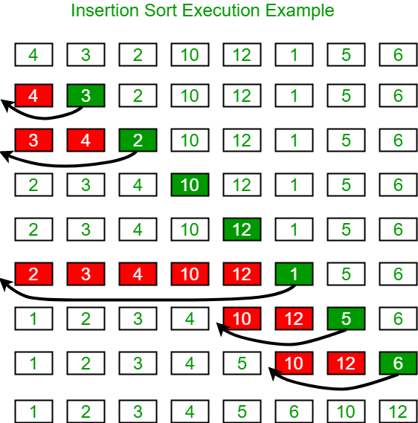
Insertion Sort
As it progresses through the data it leaves a sorted list behind.
Sorting is limited to only a fraction of the array in each iteration.
Only in the last pass is the whole array considered.
Advantage: only sorts the array if it is necessary. If the array is already sorted no substantial moves are performed

Slide 8
Insertion Sort
This sort start by considering the first two elements of the data.
If they are out of order an swap takes place
Then the third element is considered and inserted into its proper place
If the third element is less than the first and second
The first two elements are shifted by one position
Second element to pos 2 and first element to pos 1
The third element is inserted at pos 0

Slide 9
Insertion Sort Algorithm
Start with the result as the first element of the input.
Loop over the input until it is empty, "removing" the first remaining (leftmost) element.
Compare the removed element against the current result, starting from the highest (rightmost) element, and working left towards the lowest element.
If the removed input element is lower than the current result element, copy that value into the following element to make room for the new element below, and repeat with the next lowest result element.
Otherwise, the new element is in the correct location; save it in the cell left by copying the last examined result up, and start again from (2) with the next input element.

Slide 10
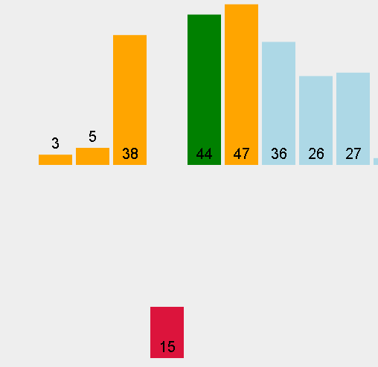
Pseudo Code – Insertion Sort
mark first element as sorted
for each unsorted element X
'extract' the element X
for j = lastSortedIndex down to 0
if current element j > X
move sorted element to the right by 1
break loop and insert X here

Slide 11
Lets code an insertion sort
Create a class called ArraySort
Create a method called insertionSort that takes an array of int as a parameter. Pass the array by reference
Now lets walk through the logic and code

Slide 12
Bubble Sort
Imagine our list standing on its end. The element [0] is on the bottom.
If we are sorting smallest to largest we want the largest value at the top of the array.
As we sort the largest value(s) bubbles to the top
This sort uses two loops to complete its operation
This sort is less efficient than the insertion sort in that it performs the swap with every element it needs to be exchanged with
In computer graphics it is popular for its capability to detect a very small errors in almost-sorted arrays and fix it with just linear complexity.
For example, it is used in a polygon filling algorithm, where bounding lines are sorted by their x coordinate and with incrementing y their order changes

Slide 13
Bubblesort
This algorithm works by repeatedly swapping the adjacent elements if they are in wrong order.
Each successive pass reduces the inspected part of the array or list by one element as the largest will have been placed at the top in its sorted position.
Therefore to sort the list we start by comparing element 1 with element 2.
If they are out of order we swap the two elements
We then move one element up in the list and repeat until we get to the top of the list
We then move our top down one and repeat the entire process
We continue until the top reference is at the bottom of the list

Slide 14
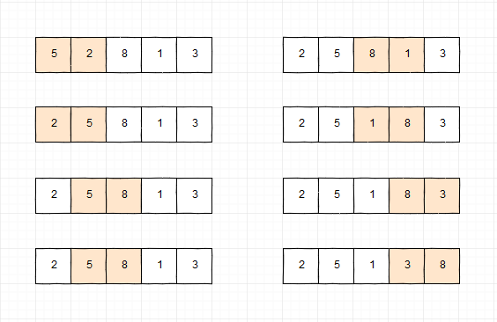
Bubblesort Pseudocode
a is an array size n
do
swapped = false
for i = 1 to indexOfLastUnsortedElement-1
if leftElement > rightElement
swap(leftElement, rightElement)
swapped = true
while swapped

Slide 15
Lets code a bubble sort
Using your class called ArraySort
Create a new method called bubbleSort that takes an array of int as a parameter. Pass the array by reference
Now lets walk through the logic and code

Slide 16
Selection Sort
Selection sort attempts to localize the exchange of elements by finding a misplaced element first and putting it in its final place.
The element with the lowest value is selected and exchanged with the element in the first position.
The next smallest element is then found and put in position 2 bhy swapping.
Repeat…
We move our starting point up one element for each iteration.
We keep track of our lowest found value and our position of comparison in the list.

Slide 17
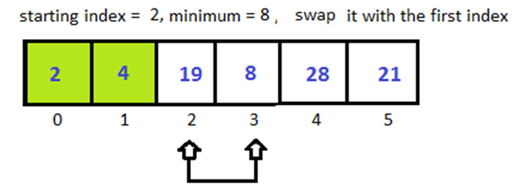
Selection sort
At each iteration find the smallest entry (the "key") in the unsorted portion of the array.
Swap the "key" with the current entry.
Pseudo Code
repeat (numOfElements - 1) times
set the first unsorted element as the minimum
for each of the unsorted elements
if element < currentMinimum
set element as new minimum
swap minimum with first unsorted position

Slide 18
Lets code a selection sort
Using your class called ArraySort
Create a new method called selectionSort that takes an array of int as a parameter. Pass the array by reference
Now lets walk through the logic and code

